Slide 2
Visualize Your Data (CollectionView, CarouselView, & Beyond)
Gerald Versluis
Javier Suárez

Slide 3
Who are you listening to?
Javier Suárez
Software Engineer Xamarin.Forms Team
@jsuarezruiz
Gerald Versluis
Software Engineer Xamarin.Forms Team
@jfversluis

Slide 4
The agenda
CollectionView
Layout options
Snap Points
ScrollTo
EmptyView
Selection
Grouping
Item Spacing
Scroll mode
Header/Footer
Nested
CarouselView
Layout options
Snap Points
Scroll Options
Peek and Spacing
EmptyView
IndicatorView
Use with CarouselView
Customization
RefreshView
Pull To Refresh
Customization
SwipeView
Directions
Modes
BehaviorOnInvoked
Command
Use in Collections
Custom SwipeItem

Slide 5
CollectionView

Slide 6
CollectionView
CollectionView is a view for presenting lists of data using different layout specifications. It aims to provide a more flexible, and performant alternative to ListView.
<CollectionView ItemsSource="{Binding Monkeys}">
<CollectionView.ItemsLayout>
<LinearItemsLayout Orientation="Vertical" />
</CollectionView.ItemsLayout>
<CollectionView.ItemTemplate>
<DataTemplate>
...
</DataTemplate>
</CollectionView.ItemTemplate>
</CollectionView>

Slide 7
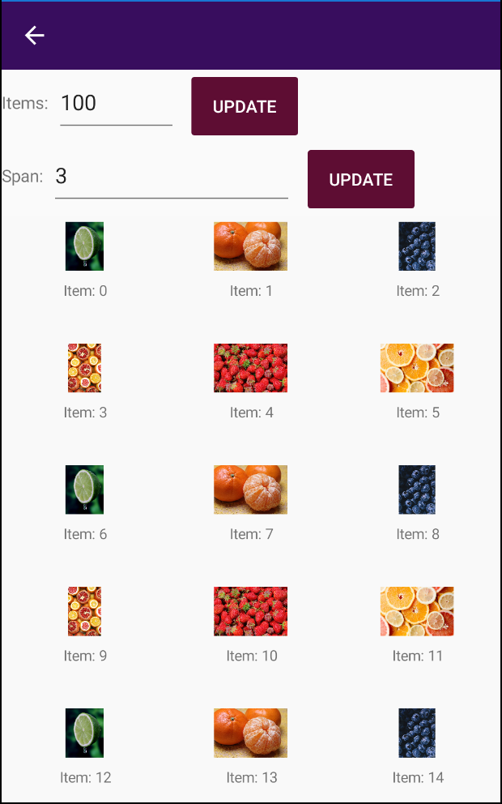
CollectionView Customizations
Out of the box this is what you can do with CollectionView:
Data binding with templates
Different layouts
Horizontal, Vertical and Grid
Item selection
Empty view
Scrolling
Event with lots of info
ScrollTo method
And much more!

Slide 8
DEMO: CollectionView

Slide 9
CarouselView

Slide 10
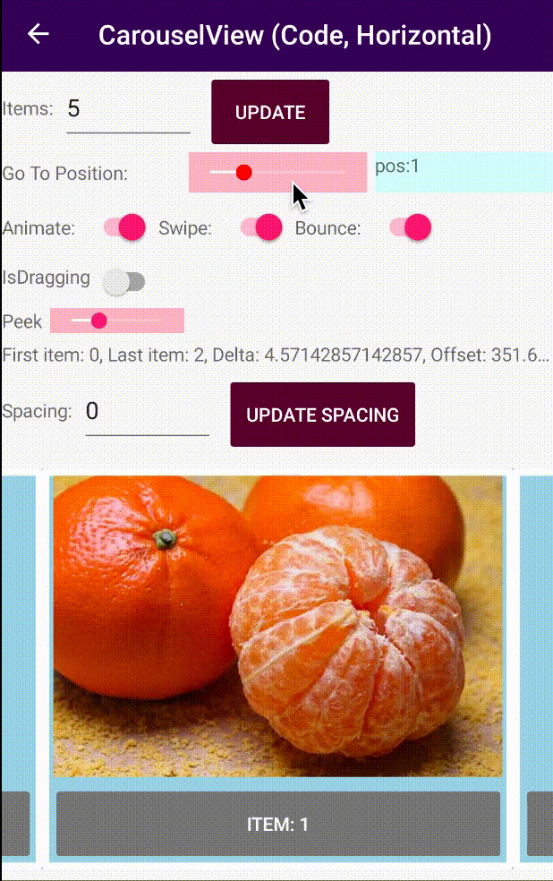
CarouselView (preview)
CarouselView is a view for presenting data in a scrollable layout, where users can swipe to move through a collection of items.

Slide 11
CarouselView (preview)
CarouselView is built on top of CollectionView, so you get a lot of the functionality for free.
Show data in a visually appealing way, very popular in modern apps.
More suitable for limited length data.
Also use orientation, layout, data templates, etc.
Works perfectly together with IndicatorView.
Note: in preview right now, needs the experimental flag.

Slide 12
DEMO: CarouselView

Slide 13
IndicatorView

Slide 14
IndicatorView
The IndicatorView allows to indicate which is the current element of a collection.
Normally, the IndicatorView is associated with a CarouselView. We associate the controls using the IndicatorView property from the CarouselView.
Note: in preview right now, needs the experimental flag.
var indicatorView = new IndicatorView
{
HorizontalOptions = LayoutOptions.Center,
IndicatorColor = Color.Gray,
SelectedIndicatorColor = Color.Black,
IndicatorsShape = IndicatorShape.Square
};
carouselView.IndicatorView = indicatorView;

Slide 15
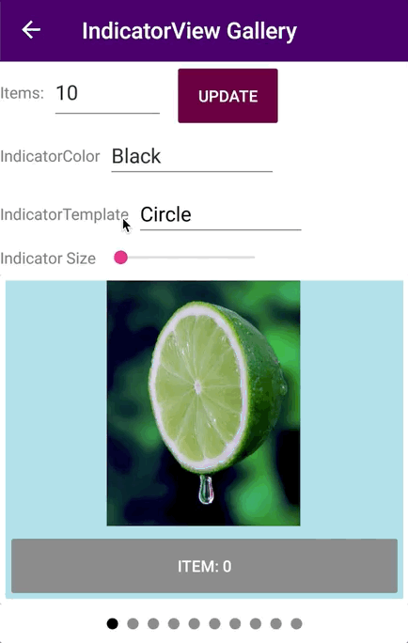
IndicatorView Possibilities
IndicatorView has a variety of customization options:
IndicatorColor: Is the color of the indicators.
SelectedIndicatorColor: the color of the indicator that represents the current item in the CarouselView.
IndicatorShape: the shape of each indicator. By default can use circle or rectangle.
IndicatorTemplate: the template that defines the appearance of each indicator.
IndicatorSize: the size of the indicators.

Slide 16
DEMO: IndicatorView

Slide 17
RefreshView

Slide 18

Pull To Refresh
Pull-to-refresh lets a user pull down on a scrollable content in order to retrieve more data. The main control to allow pull to refresh is the RefreshView, which you place as a wrapper around scrollable content that the user pulls to trigger a refresh.

Slide 19
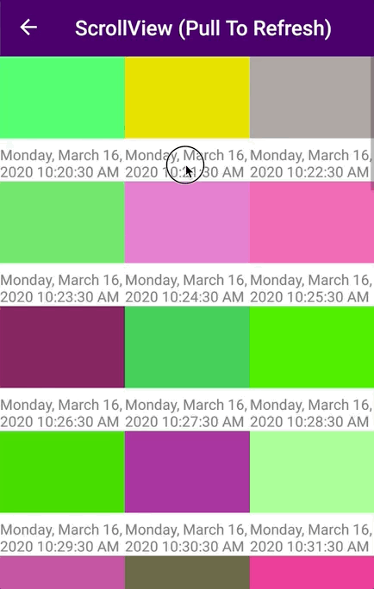
Implement Pull To Refresh
To add pull-to-refresh functionality to a list requires just two steps:
Wrap your scrollable content (list) in a RefreshView control.
Handle the Command to refresh your content.
<RefreshView
IsRefreshing="{Binding IsRefreshing}"
Command="{Binding RefreshCommand}">
<ListView
ItemsSource="{Binding Items}">
…
</ListView>
</RefreshView>

Slide 20
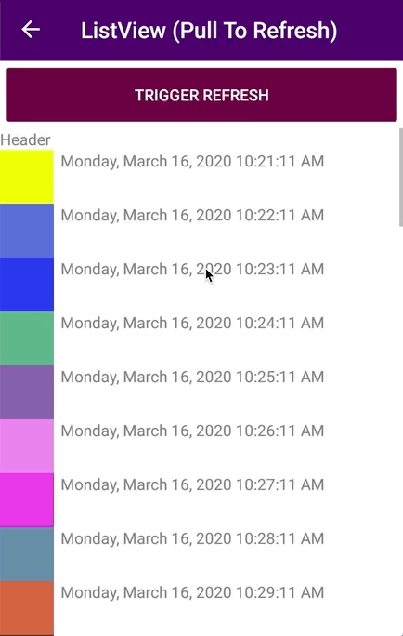
Customize the Refresh Indicator
To customize the background color of the refresh indicator as well as the color of the indicator can use the BackgroundColor and RefreshColor properties respectively.
<RefreshView
IsRefreshing="{Binding IsRefreshing}"
BackgroundColor="Red"
RefreshColor="Yellow"
Command="{Binding RefreshCommand}"
HorizontalOptions="FillAndExpand"
VerticalOptions="FillAndExpand" />

Slide 21
DEMO: RefreshView

Slide 22
SwipeView

Slide 23

SwipeView
Swipe commanding is an accelerator for context menus that lets users easily access common menu actions, without needing to change states within the app.

Slide 24
How does Swipe work?
SwipeView commanding has two modes: Reveal and Execute. It also supports four different swipe directions: up, down, left, and right.
In Reveal mode, the user swipes an item to open a menu of one or more commands and must explicitly tap a command to execute it.
In Execute mode, the user swipes an item open to reveal and execute a single command with that one swipe. If the user releases the item being swiped before they swipe past a threshold, the menu closes and the command is not executed. If the user swipes past the threshold and then releases the item, the command is executed.
Note: in preview right now, needs the experimental flag.

Slide 25
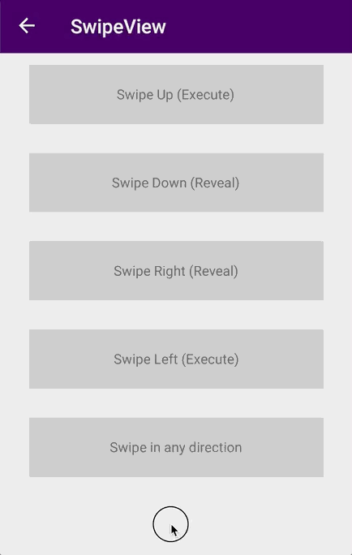
Swipe Directions
Swipe works in all cardinal directions: up, down, left, and right. Each swipe direction can hold its own swipe items or content, but only one instance of a direction can be set at a time on a single swipe-able element.
<SwipeView>
<SwipeView.LeftItems>
<SwipeItems Mode="Reveal">
<SwipeItem
Text="Delete"
Icon="delete.png"
BackgroundColor="Red"
Invoked="OnInvoked"/>
</SwipeItems>
</SwipeView.LeftItems>
<SwipeView.Content>
<Grid BackgroundColor="LightGray">
<Label
HorizontalOptions="Center"
VerticalOptions="Center"
Text="Swipe Right (Reveal)"/>
</Grid>
</SwipeView.Content>
</SwipeView>

Slide 26
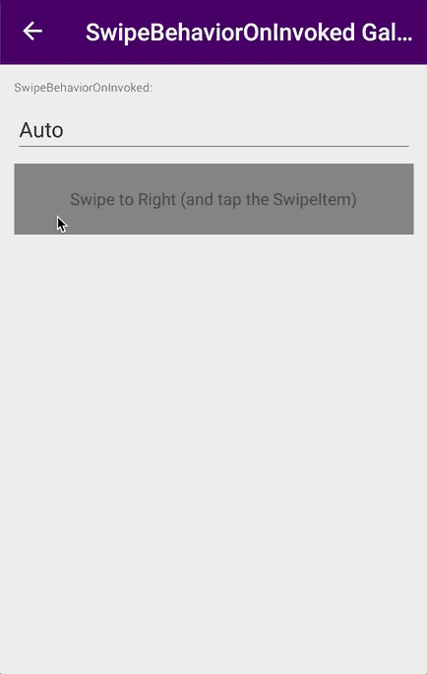
Swipe BehaviorOnInvoked
In situations where you simply want to perform an action and then maintain the swipe open, you can set the BehaviorOnInvoked property one of the SwipeBehaviorOnInvoked enum values.
Auto: The opened swipe item will collapse when invoked.
Close: When the item is invoked, the SwipeView will always collapse and return to normal, regardless of the mode.
RemainOpen: When the item is invoked, the SwipeView will always stay open.

Slide 27
Handle an invoked swipe command
To act on a swipe command, you handle its Invoked event.
<SwipeItem
Text="Delete"
Icon="delete.png"
BackgroundColor="Red”
Command="{StaticResource DeelteCommand}"
Invoked="OnDeleteInvoked"/>
void OnDeleteInvoked(object sender, EventArgs e)
{
}

Slide 28
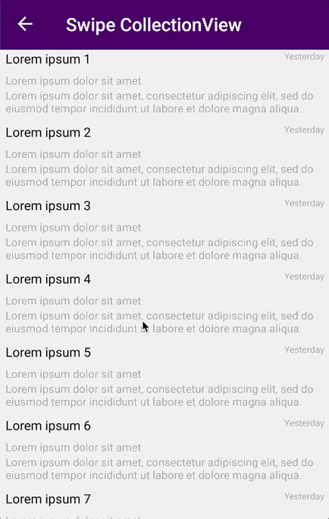
SwipeView in Collections
SwipeView in combination with BindableLayout, CollectionView, CarouselView, ListView or any control managing a collection allow to manage contextual options.
<CollectionView
ItemsSource="{Binding Items}">
<CollectionView.ItemTemplate>
<DataTemplate>
<SwipeView>
...
</SwipeView>
</DataTemplate>
</CollectionView.ItemTemplate>
</CollectionView>

Slide 29
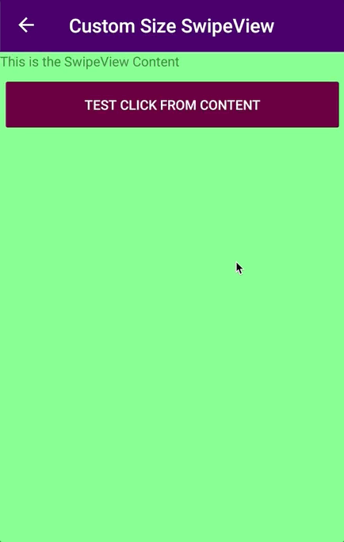
Custom SwipeItems
In addition to SwipeItem we have SwipeItemView that allows us to include a View as content, that is, we can create fully customized SwipeItems.
<SwipeView.TopItems>
<SwipeItemView>
<StackLayout
BackgroundColor="LightSkyBlue"
HeightRequest="100">
<Label
Text="This is the TopItems Content"
Margin="12"/>
<Button
Text="Click me!"
Clicked="OnButtonClicked"/>
</StackLayout>
</SwipeItemView>
</SwipeView.TopItems>

Slide 30
DEMO: SwipeView

Slide 31
Upcoming features
Do you want to know what functionality will come soon to this group of controls?
CarouselView
Cyclic CarouselView.
CarouselView VisualStates.
SwipeView
Modify the swipe threshold.
Programmatically open and close the SwipeView.
Hide or disable SwipeItems.
<VisualStateManager.VisualStateGroups>
<VisualStateGroup x:Name="CarouselViewStates">
<VisualState x:Name="CurrentItem">
<VisualState.Setters>
<Setter Property="Opacity" Value="1" />
</VisualState.Setters>
</VisualState>
<VisualState x:Name="PreviousItem">
<VisualState.Setters>
<Setter Property="Opacity" Value="0.7" />
</VisualState.Setters>
</VisualState>
<VisualState x:Name="NextItem">
<VisualState.Setters>
<Setter Property="Opacity" Value="0.7" />
</VisualState.Setters>
</VisualState>
<VisualState x:Name="DefaultItem">
<VisualState.Setters>
<Setter Property="Opacity" Value="0.2" />
</VisualState.Setters>
</VisualState>
</VisualStateGroup>
</VisualStateManager.VisualStateGroups>

Slide 32
Good Looking UI samples

Slide 33
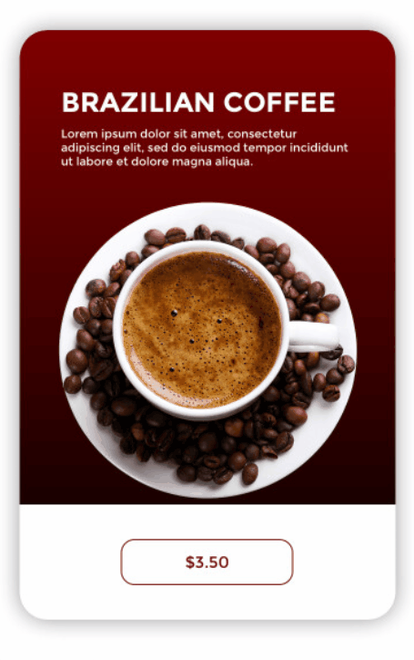
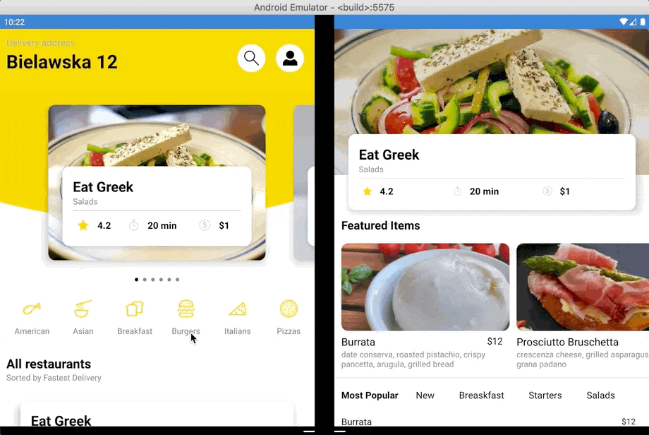
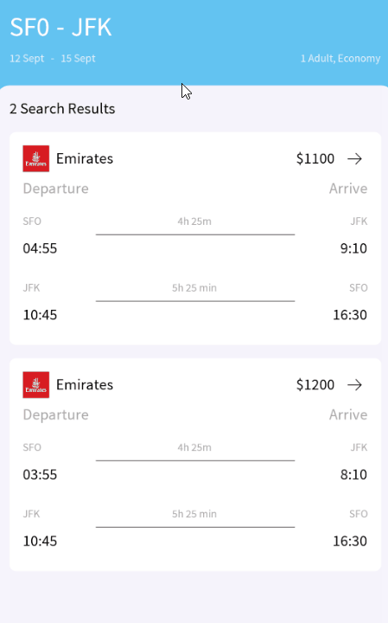
Good Looking UI Samples
Now that we have taken a look at the CollectionView, CarouselView, RefreshView and SwipeView concepts, let’s see how to use this controls in some Good Looking UI samples.

Slide 34
DEMO: GoodLooking UI Samples

Slide 35
Visualize Your Data (CollectionView, CarouselView, & Beyond)
https://github.com/jsuarezruiz/FocusOnXamarin
https://github.com/jsuarezruiz/xamarin-forms-goodlooking-UI

